Slide 1
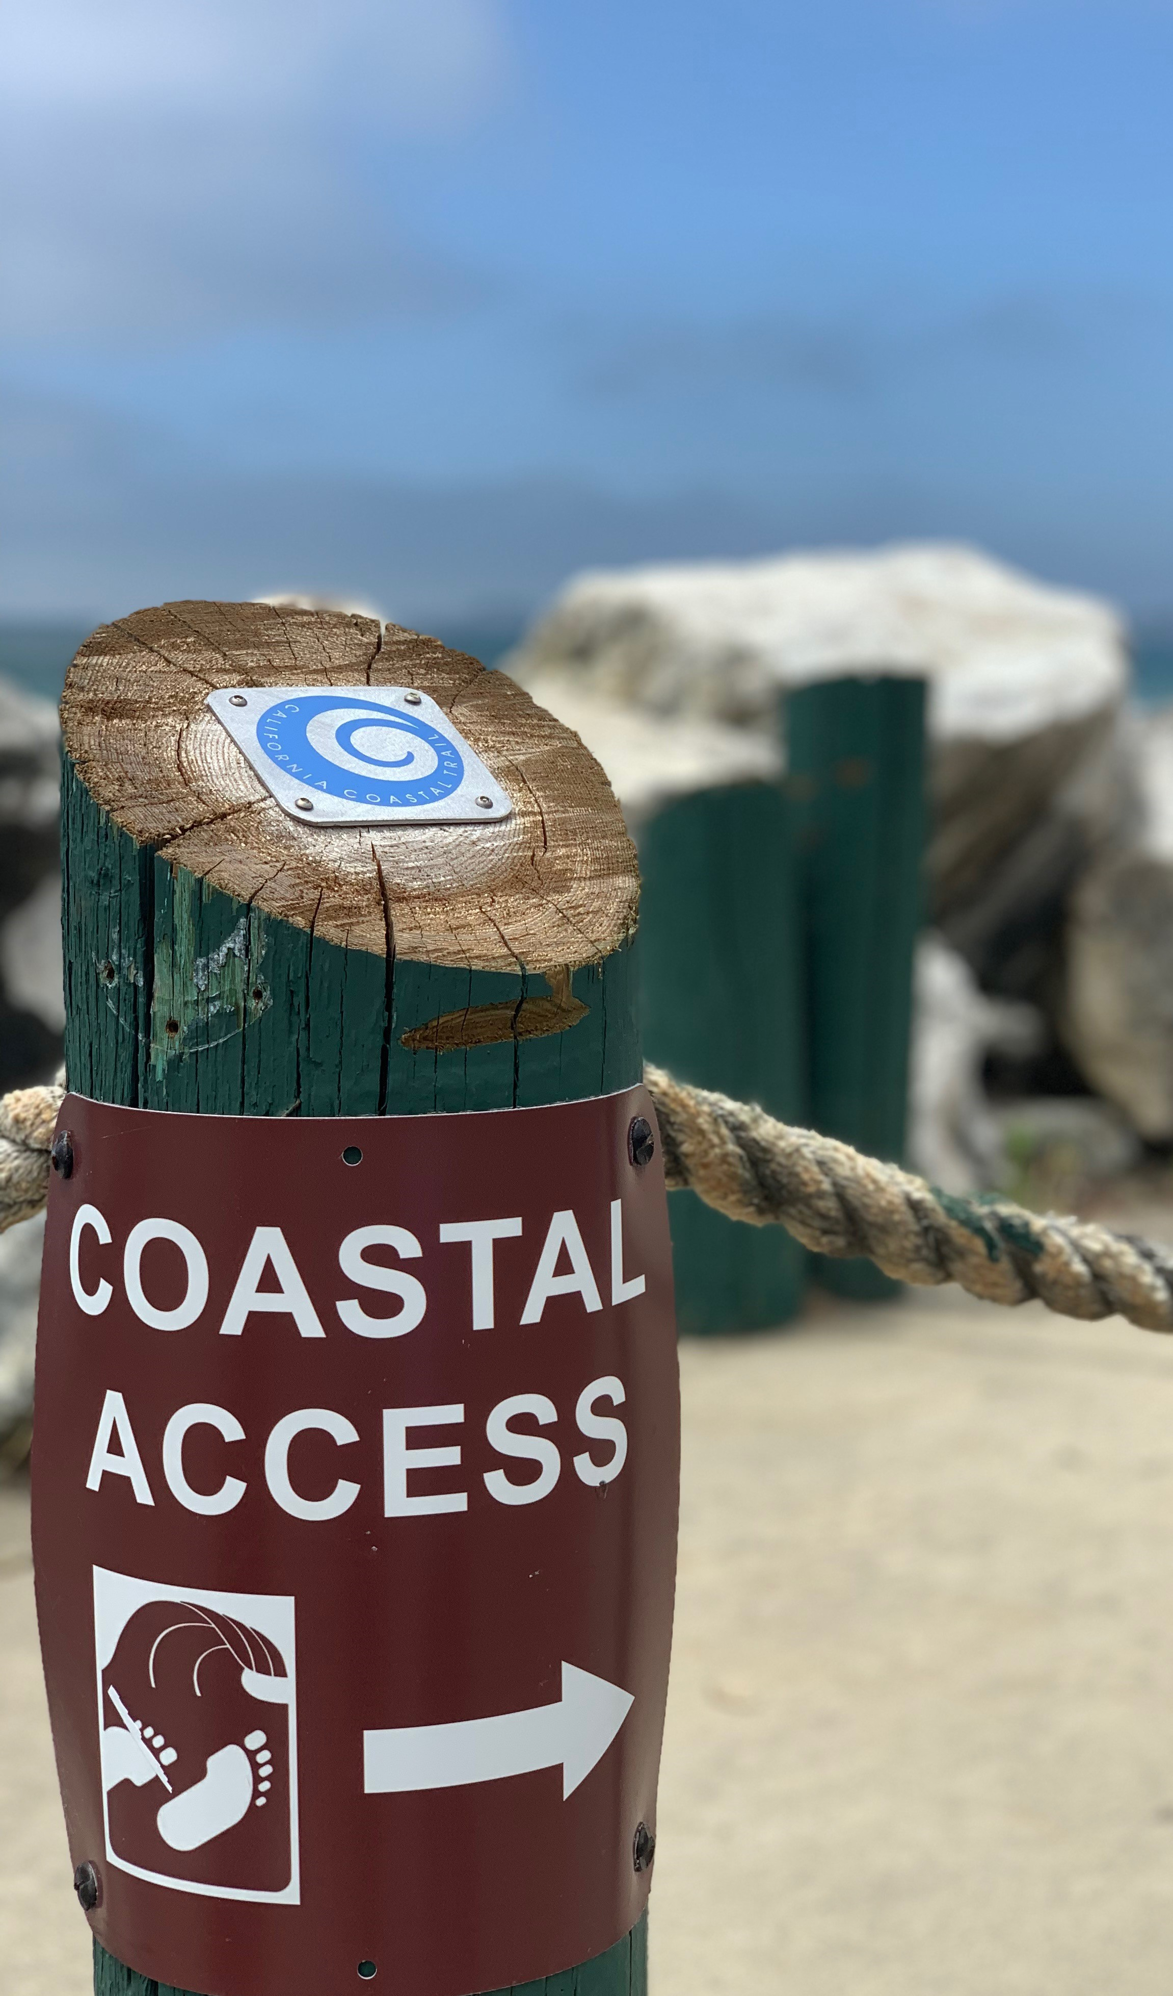
Coastal Encroachment Program
Santa Cruz County Parks Department
Notes:
Presentation includes:
Timeline of the program
Statistics on applications and permits
How Parks receives notice of possible encroachments
How reviews are processed
Surveys
313 Johans Beach Drive (an example)
Goals of the Program
Principles of the Program
Fees

Slide 2
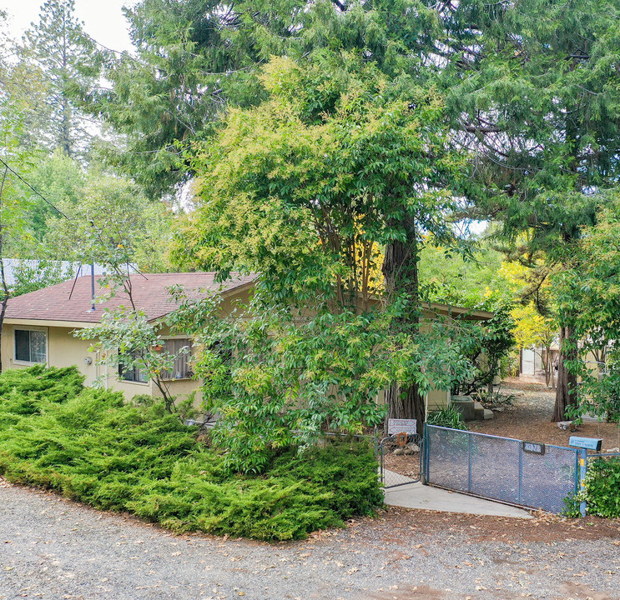
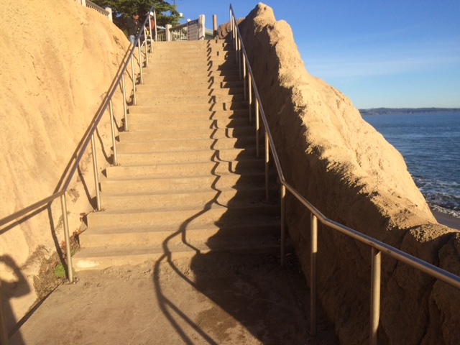
History of encroaching private improvements
Many streets in the coastal areas do not have sidewalks or curbs and gutters to define the edge of the public right-of-way (ROW).
Over time, encroachments of private landscaping, patios, fences, private parking, and other encroachments in the public right-of-way have grown significantly.
Example of private landscaping encroaching into ROW
Notes:
Approach review of all possible encroachments consistently and fairly to avoid arbitrary and capricious decisions. Staff accomplishes this by requiring a complete application (including proposed site plans showing private and public property boundaries) submitted by the property owner prior to forming a determination.
Provide clear communication with applicants, particularly explaining what a Coastal Encroachment Permit covers and what it does not as well as explaining when additional permits, like a Coastal Development Permit (CDP) or building permit, may be required.

Slide 3
Program’s Purpose & Goals
The Coastal Encroachment Program was approved by the County Board of Supervisors to:
Improve Coastal Access with:
Stairs
Trails
Public parking
Scenic vistas
and more
Improve Communication
between all agencies with
jurisdiction along the coast
Improve Consistency
in the way the County
addresses encroachments
36th Avenue Stairs
Notes:
Approach review of all possible encroachments consistently and fairly to avoid arbitrary and capricious decisions. Staff accomplishes this by requiring a complete application (including proposed site plans showing private and public property boundaries) submitted by the property owner prior to forming a determination.
Provide clear communication with applicants, particularly explaining what a Coastal Encroachment Permit covers and what it does not as well as explaining when additional permits, like a Coastal Development Permit (CDP) or building permit, may be required.

Slide 4
Coastal Encroachment Applications
Property owners with existing encroachments or those proposing encroachments onto public property should:
Submit a complete application to County Parks, including:
current application fees;
site plan; and
approximate square footage of the encroachment.
Coordinate with County Parks during the encroachment application review process.
Notes:
As part of forming an application determination, County Parks discusses alternatives with the partner agencies
Example: Johans Beach Drive encroachments include private parking signs, landscaping, and fencing in the public right-of-way

Slide 5
Coastal Encroachment Applications & Determinations
County Parks will coordinate with the appropriate agencies and the property owner to determine the extent of the encroachment(s) and craft possible resolutions.
After application review, County Parks will determine if the best approach includes:
permitting encroachments
removal of existing encroachments, or
a hybrid of permitting/removal of encroachments.
Notes:
As part of forming an application determination, County Parks discusses alternatives with the partner agencies
Example: Johans Beach Drive encroachments include private parking signs, landscaping, and fencing in the public right-of-way

Slide 6
Coastal Encroachment Applications & Determinations
Encroachments may be permitted to remain if, at the time of application, the encroachments are not impeding public access to the coast and are not located in an area where improvements are planned in the near term. Encroachment permits must be renewed annually.
Encroachments may need to be removed if, at the time of application, the encroachments are impeding public access to the coast or are located in areas where improvements are planned in the near term.
Notes:
As part of forming an application determination, County Parks discusses alternatives with the partner agencies
Example: Johans Beach Drive encroachments include private parking signs, landscaping, and fencing in the public right-of-way

Slide 7
Example A (Encroachments permitted) Determination: Non-conforming encroachments are not impeding existing or planned public access to the coast. Action: Permit encroachments and process annual fees based on square footage of encroachments.
Public Right-of-Way
Planter box
Private Property with Single Family Residence
Notes:
Scenario A: County Parks could receive approximately $125,000 annually if all existing encroachments were permitted. Fees could be used to improve the Sunny Cove access with benches, bike racks, stairs, etc.

Slide 8
Example B (Encroachments removed) Determination: Non-conforming encroachments are impeding public access to the coast or are in an area planned for future coastal access improvements. Action: Remove encroachments and install coastal access improvements using revenue generated by the Coastal Encroachment Program.
Public Right-of-Way
Property Line
Private Property with Single Family Residence
Notes:
Scenario A: County Parks could receive approximately $125,000 annually if all existing encroachments were permitted. Fees could be used to improve the Sunny Cove access with benches, bike racks, stairs, etc.

Slide 9
Example A/B Hybrid Determination: Certain encroachments are impeding access to the coast. Action: Permit/Remove specific encroachments - Specific landscaping/area is permitted - Specific landscaping /area is removed - Coastal access improvements are installed and maintained using revenue generated by the Coastal Encroachment Program.
Public Right-of-Way
Private Property with Single Family Residence
Notes:
Scenario A: County Parks could receive approximately $125,000 annually if all existing encroachments were permitted. Fees could be used to improve the Sunny Cove access with benches, bike racks, stairs, etc.

Slide 10
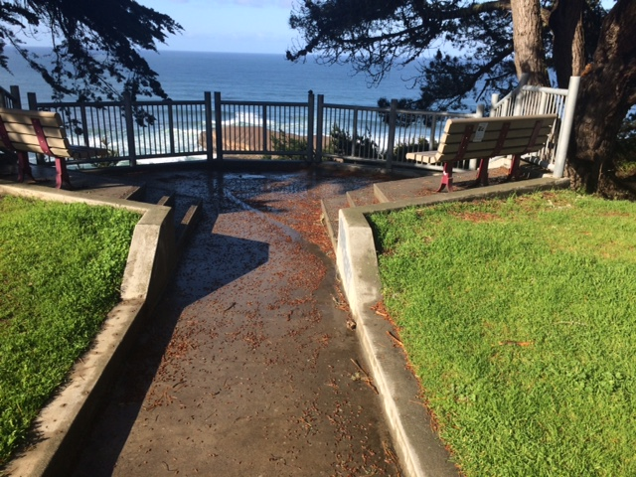
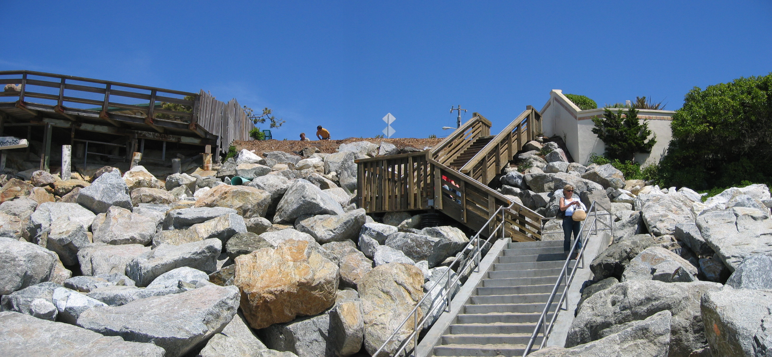
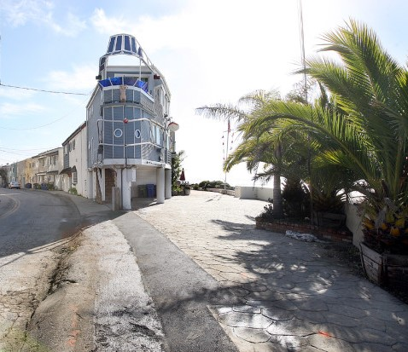
Revenue & Improvement Projects
Revenue generated by permits is used to maintain and improve coastal access.
Accounts have been set up for coastal access improvements within three zones (North, Mid, and South), which match coastal supervisorial districts, guaranteeing the money is spent in the same area where fees are assessed.
Greyhound Rock
26th Ave Stairs
Beach Island
Notes:
Permits:
Provided input on over 50 coastal encroachment cases
Issued seven temporary encroachment waivers
Received three complete Coastal Encroachment Permit applications
One 20-year permit issued
One annual permit issued
One permit denied
Twelve incomplete permit applications in process or pending
Note: County Parks does not perform an official review of a Coastal Encroachment Permit until a complete application is received
Fees:
Fees kept in separate trust funds
Use of fees: Improved coastal access features and Coastal improvement projects
Examples include installation, operation, and maintenance of public parking, benches, bike racks, etc. at locations such as Beach Island and Rockview County Park.
In addition to fees raised from Coastal Encroachment Permit application review and collection of annual fees, the state Coastal Commission is willing to direct fees and fines from their enforcement program to County Parks to be used for coastal improvement projects.

Slide 11
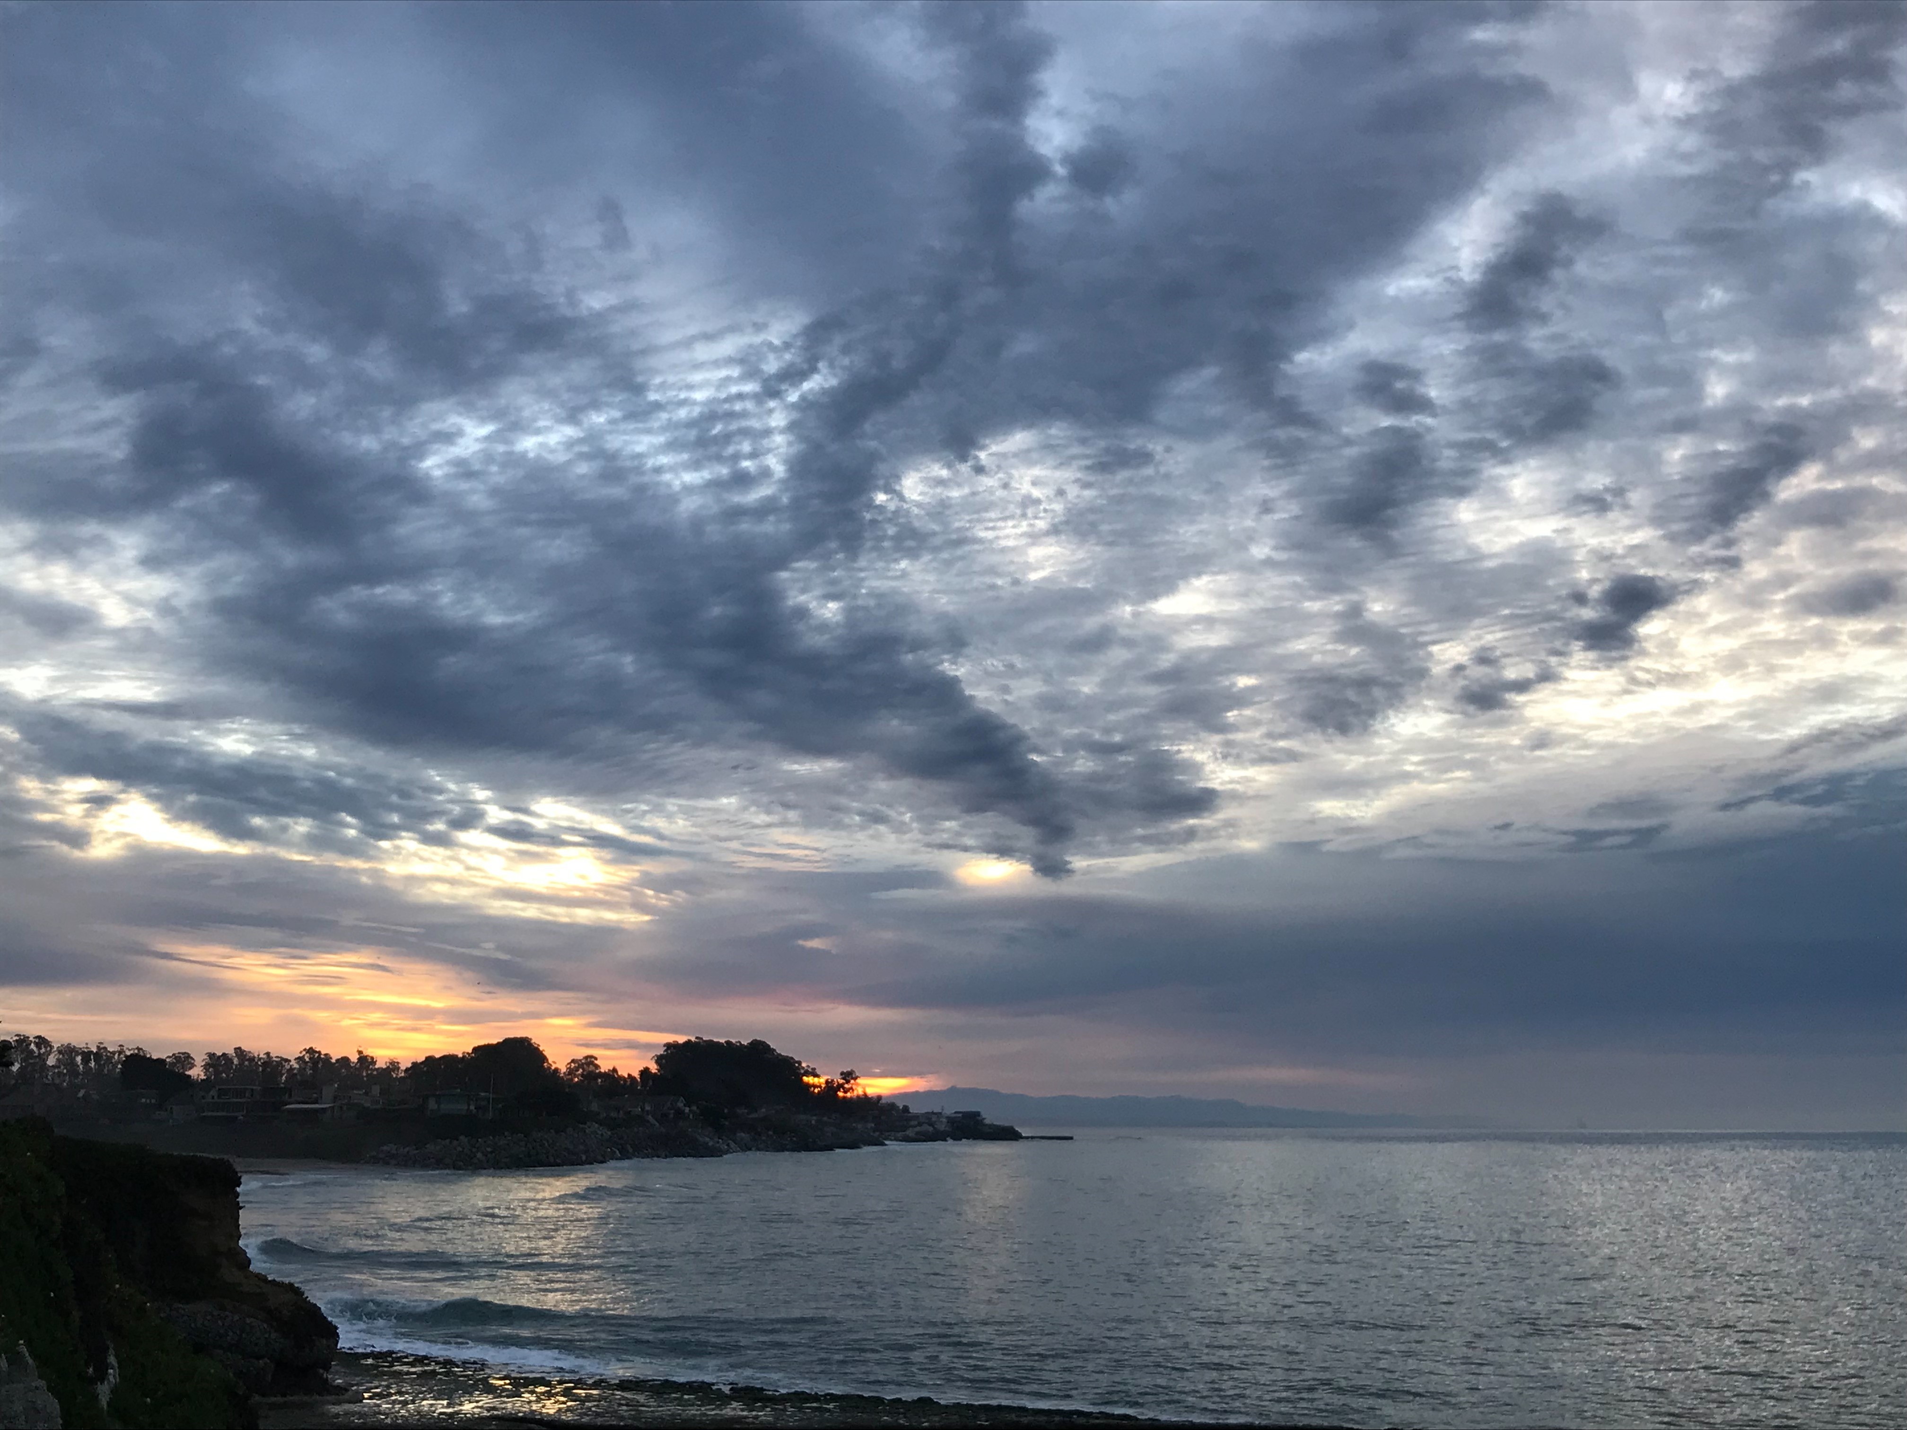
Applications & Fees
Fees for Fiscal Year 2021/2022
Application Fee: $1,123.63
Annual Exclusive Encroachment Fee: $17.17 per square foot annually
Annual Non-Exclusive Encroachment Fee: $6.76 per square foot annually, capped at $5,202 per parcel annually
For most current fees, please visit the County's Unified Fee Schedule.
Notes:
Permits:
Provided input on over 50 coastal encroachment cases
Issued seven temporary encroachment waivers
Received three complete Coastal Encroachment Permit applications
One 20-year permit issued
One annual permit issued
One permit denied
Twelve incomplete permit applications in process or pending
Note: County Parks does not perform an official review of a Coastal Encroachment Permit until a complete application is received
Fees:
Fees kept in separate trust funds
Use of fees: Improved coastal access features and Coastal improvement projects
Examples include installation, operation, and maintenance of public parking, benches, bike racks, etc. at locations such as Beach Island and Rockview County Park.
In addition to fees raised from Coastal Encroachment Permit application review and collection of annual fees, the state Coastal Commission is willing to direct fees and fines from their enforcement program to County Parks to be used for coastal improvement projects.

Slide 12
Any questions? Contact: Encroachment@scparks.com
Greyhound Rock County Park

